Slide 1

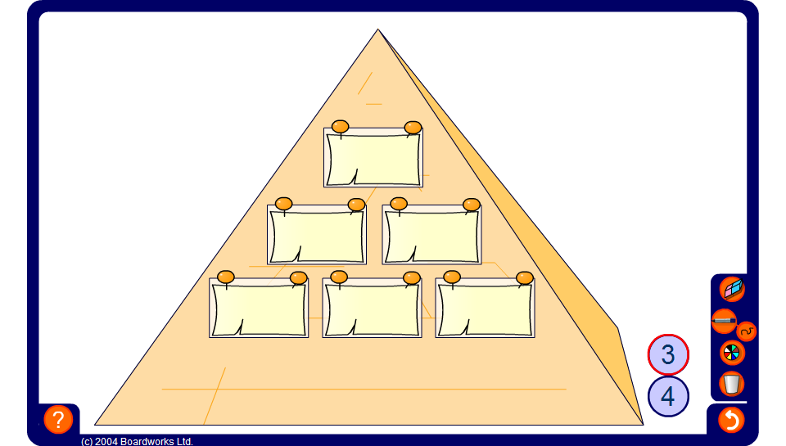


Algebraic pyramids
Notes:
Use the algebraic pyramid to practise collecting together like terms. Start by revealing all of the expressions along the bottom row of the pyramid. Find the expression in each brick by adding the two expressions below it.
Modify the activity by revealing expressions in the bricks above and one of the expressions in the bricks below it. Pupils must then subtract expressions to find those that are hidden.

